Slide 1
Receipt Keeper
PROG 8220
C. Choi, H. Nahhal, N. Collins, S. Kim

Slide 2
Outline

Slide 3
Introduction
`
http://netsecurity.about.com/od/advancedsecurity/a/How-To-Stay-Safe-On-Craigslist.htm
http://blog.spacesavers.com/5-tips-for-organizing-receipts-for-taxes/
http://www.shoeboxservices.ca/resources/

Slide 4
Problem
Waste of time and resources
Forget stuff bought
Household with one income source
Company with many buyers and one account
55,000 receipts can spare an entire tree
250 M gal of oil + 10M tree + 1B gal= 680388 ton of waste (USA)
Current alternatives dont give the ultimate solution

Slide 5
Our Solution
Mobile application that will:
Make use of Optical Character Recognition to gather data
Filter receipts based on date
Search for receipt by tag
Generate reports to track expenses
Group account for multiple users (family or business)
View spending for a specific category
Export data as files (PDF, excel..)

Slide 6
Technologies Used

Slide 7
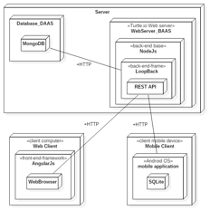
Technologies Used (Cont.)
Fig 1. Deployment Diagram (Server, Web and Mobile Client)

Slide 8
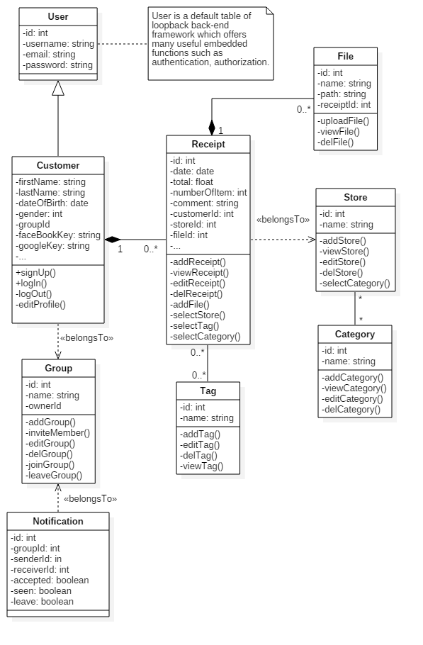
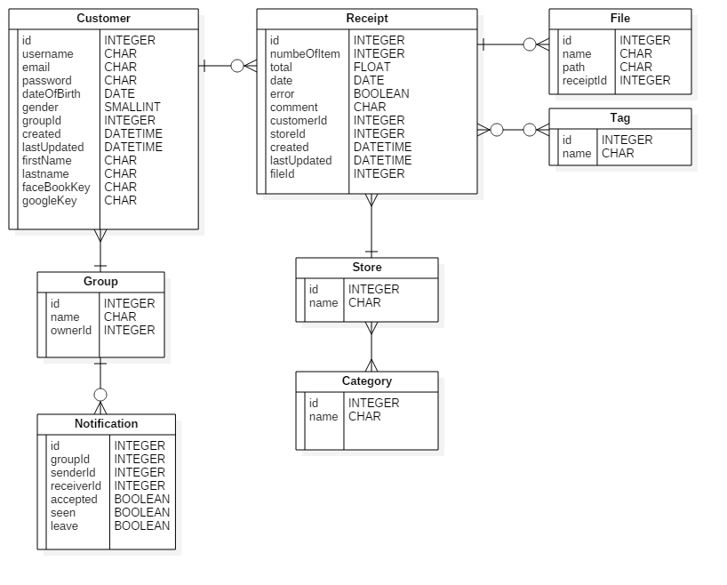
Technical Diagrams
Fig 1. Class Diagram
Fig 2. ERD

Slide 9
Methodologies
Development Methodologies & Team Rules
Agile Unified Process with 2 week iteration
Coding Standards to follow for web and mobile development
Source Control & Change Management
3 GitHub repositories
Master, dev_prod, and branching out from dev_prod for developer’s task
Wiki was used to share info and keep track of process, meetings and others
Issues tracking to assign fixes or tasks
Communication
Slack and regular meetings

Slide 10
Screenshots

Slide 11
Future Plans

Slide 12
Conclusion

